Slide 1
PRESCRIPTION LABEL READING
DETAILED PROJECT REPORT
BRILLIABIBIN

Slide 2
PROJECT DETAILS
PROJECT TITLE | Prescription Label Reading
TECHNOLOGY | Deep Learning Technology (Computer Vision)
DOMAIN | Healthcare
PROJECT DIFFICULTY LEVEL | Intermediate
PROGRAMMING LANGUAGE USED | PYTHON
TOOLS USED | JUPYTER NOTEBOOK,VSCODE

Slide 3
OBJECTIVE
To build a solution that should recognize and identify the text in the prescriptions and should read out the name of medicines and dosage limits to the visually impaired patients.

Slide 4
PROBLEM STATEMENT
Support elderly or vulnerable patients should be a focus for many businesses. This is especially true for those in the health care sector. Enabling voice messages can make it easier for elderly people to understand your message. Text-to-Speech can provide peace of mind by empowering you to give better services.
For example, we could even send voice messages that read prescription labels. This can be a real challenge for anyone with reading difficulties, not to mention the elderly and visually impaired. A talking label, sent straight to your device, makes it easy to know everything about your medication. Dosage info can also be tracked and shared with caregivers.

Slide 5
APPROACH
We need to apply OCR techniques to extract the text data from the prescriptions and convert them into speech.

Slide 6
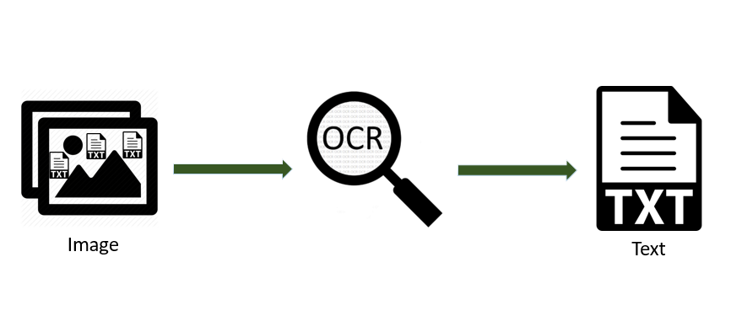
ARCHITECTURE

Slide 7
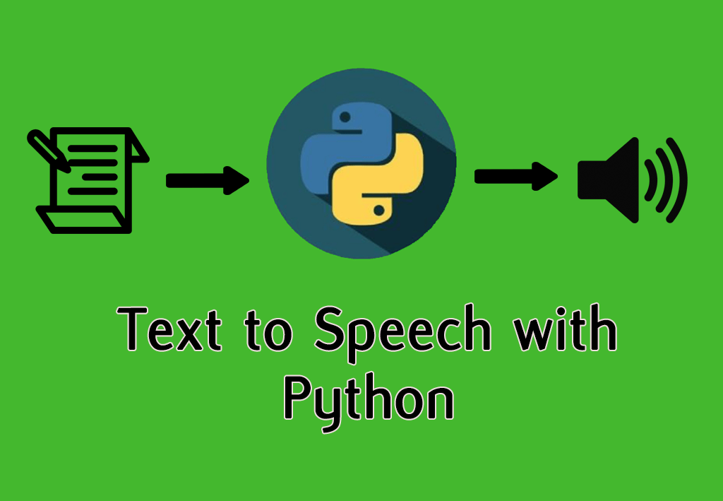

Slide 8
process
STEP 1: upload an image.
STEP 2: Extracts Text Region.
STEP 3: Extracted text region undergoes text binarization and recognition.
STEP 4: Text recognition is performed by OCR.
STEP 5:Displaying label in the form of text.
STEP 6: Text is converted to speech.

Slide 9
CONCLUSION
We are able to obtain text data from an image and can convert into speech form with choice of language.

Slide 10


